Slide 1

INTERNATIONAL MARIETIME BOUNADRY DETECTION SYSTEM
TEAM MEMBERS:
LOKESH SINGH N (230701166)
KIRUTHIKA K M (230701153)
MONISH G (230701196)

Slide 2
AGENDA
1. Abstract 2. Problem Statement
3. Objectives 4. Literature Survey
5. Existing System 6. Proposed System
7. System Architecture 8. Technologies Used
9. Future Enhancements 10. References

Slide 3
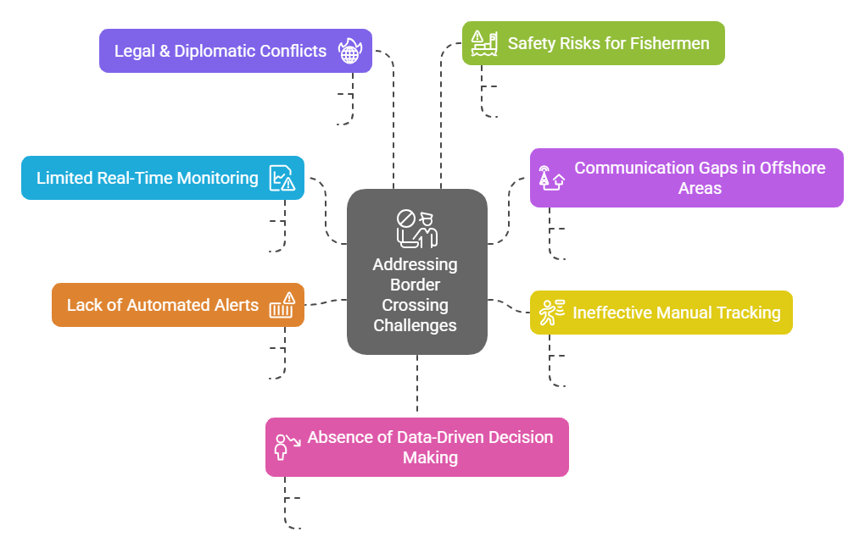
The Maritime Border Alert System automates real-time tracking and warnings for fishermen near international boundaries using GPS and LoRa communication. Fishermen’s locations are continuously monitored, and alerts are triggered if they approach or cross restricted waters. The system operates without internet, using LoRa to transmit coordinates to an onshore server, which processes the data and issues alerts via mobile devices or onboard systems. Automated detection, real-time notifications, and data logging enhance maritime security, prevent accidental border crossings, and ensure compliance with international regulations while safeguarding fishermen.
ABSTRACT

Slide 4
OBJECTIVES
To monitor the real-time location of fishermen near maritime borders using GPS and LoRa communication.
To automatically detect and alert when vessels approach or cross restricted maritime boundaries.
To reduce accidental border crossings and improve safety by providing timely warnings without internet dependency.
To ensure compliance with international maritime regulations through automated tracking and data logging.

Slide 5
LITERATURE SURVEY
1️⃣ Smart Maritime Boundary Monitoring Using IoT Technologies Discusses various IoT-based methods for maritime surveillance, emphasizing GPS and wireless communication (like LoRa) to track and alert vessels near international borders. Highlights the challenges of connectivity and real-time enforcement.
2️⃣ Application of LoRa in Remote Maritime Areas Analyzes the use of LoRaWAN technology for long-range communication in offshore regions. It reviews successful case studies where LoRa was used to maintain low-power, reliable communication between vessels and coastal stations.
3️⃣ Fishermen Safety and Maritime Security: A Review of Technological Solutions Reviews existing safety measures for fishermen, underlining the limitations of manual monitoring and the growing need for automated alert systems using GPS-based technologies for improved border safety.

Slide 6
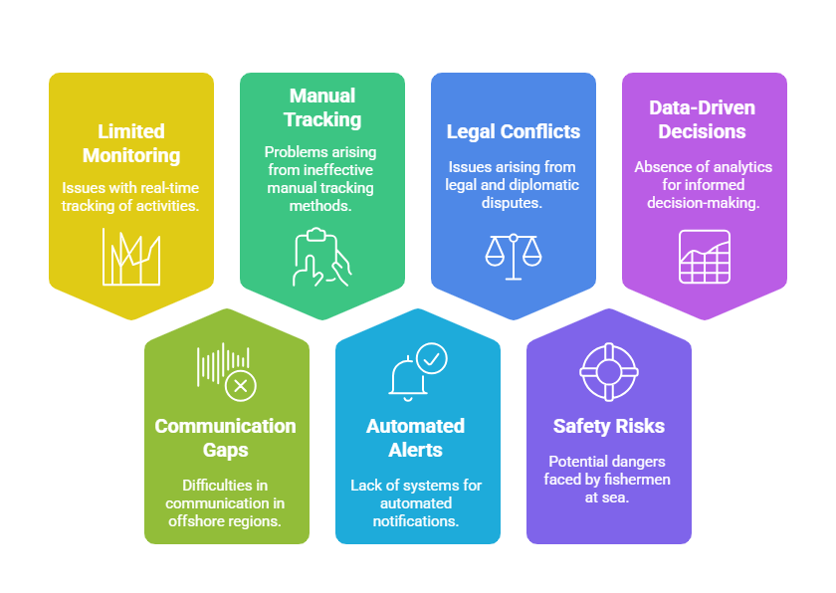
PROBLEM STATEMENT
Manual monitoring of fishermen near maritime borders is inefficient, prone to errors, and lacks real-time enforcement, leading to accidental border crossings and security risks. There is a need for an automated GPS-based tracking system using LoRa to detect, alert, and prevent violations, ensuring safety, compliance, and efficient maritime boundary management.
PROBLEMS FACED
Accidental Border Crossings & Security Risks
Limited Real-Time Monitoring
Communication Gaps in Offshore Areas
Ineffective Manual Tracking
Lack of Automated Alerts
Legal & Diplomatic Conflicts
Safety Risks for Fishermen
Absence of Data-Driven Decision Making

Slide 7
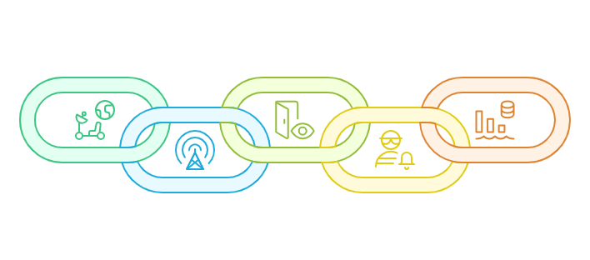
PROPOSED SOLUTION
The Maritime Border Alert System automates real-time tracking and warnings for fishermen using GPS and LoRa communication. Fishermen’s locations are continuously monitored, and if they approach or cross restricted waters, the system triggers instant alerts. A multi-level verification process ensures accuracy by comparing GPS data with predefined maritime boundaries. Alerts are sent via mobile notifications or onboard devices, even without internet access. The system logs all movements for security and compliance enforcement. A dispute resolution mechanism allows verification of alerts, ensuring fairness and accuracy while protecting fishermen and preventing border conflicts.

Slide 8

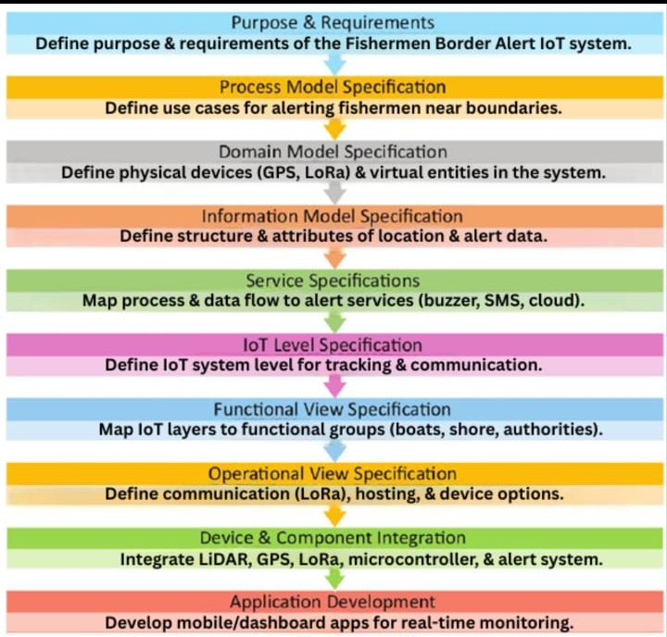
DESIGN METHODOLOGY

Slide 9
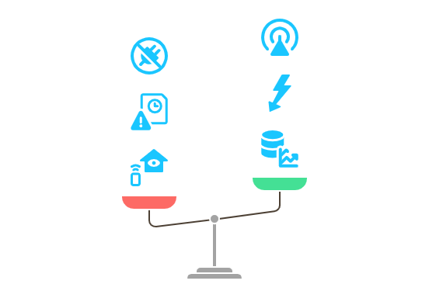
EXISTING ONES 🛑 | WE ✅
Manual Monitoring by Coast Guards | Automated GPS-Based Tracking
Limited Surveillance Coverage | Real-Time Monitoring with LoRa
Delayed Warnings & Communication Gaps | Instant Alerts for Fishermen
No Reliable Offshore Connectivity | LoRa-Based Data Transmission
Risk of Accidental Border Crossings | Automated Boundary Violation Detection
No Digital Records for Disputes | Data Logging for Compliance & Security
Dependence on Verbal Warnings | Mobile & Onboard Notification System
Potential Diplomatic Conflicts | Proactive Prevention & Fishermen Safety
EXISTING SOLUTION VS US

Slide 10
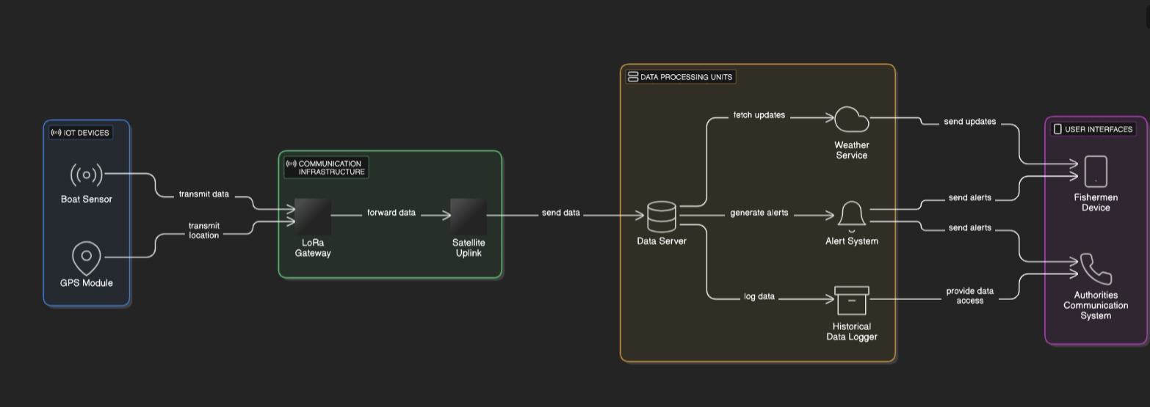
ARCHITECTURE DIAGRAM

Slide 11










TECHNOLOGIES USED
HARDWARE
GPS Module
LoRa Transmitter & Receiver
Microcontroller (ESP32/Arduino)
Power Source (Battery/Solar Panel)
Buzzer/Vibration Motor
SOFTWARE
Geospatial Database
GPS Data Processing Algorithm
LoRa Communication Protocol
Alert Notification System
Admin Dashboard (Host System - Web/App)
Client Mobile App
NAUTI-GUARD
FEASIBILTY &
VIABILITY
Technically Feasible
& Supporting
Connectivity & Precision
Meeting government
Standards
Material & Design
Market Demand
MEETING UN SUSTAINABLE GOALS
8,9,14,16
TECH STACKS
Flutter
Folium
FTP
LoraWAN
Firebase
IDE

Slide 12
FUTURE ENHANCEMENTS
Integrate predictive analytics to forecast vessel routes and preemptively warn of potential border violations.
Incorporate AI-powered image recognition using onboard cameras to identify and classify nearby vessels or obstacles.
Add support for two-way communication, allowing fishermen to request help or clarification when alerts are triggered.
Expand the system to include environmental monitoring (e.g., weather conditions, sea state) to enhance overall maritime safety.
Explore blockchain-based data logging to secure vessel movement records for legal and compliance purposes.

Slide 13
REFERENCES
A. Čolaković et al., Internet of Things (IoT): A Review of Enabling Technologies, Challenges, and Open Research Issues, 2018.
S. Ahmed et al., Real-Time Maritime Boundary Monitoring Using IoT and LoRa Technology, Journal of Marine Systems, 2020.
J. Lee et al., GPS-Based Vessel Tracking for Maritime Safety and Border Security, Ocean Engineering Journal, 2019.
M. Z. Khan et al., Application of LoRaWAN for Offshore Communication, Sensors and Actuators A: Physical, 2021.
International Maritime Organization (IMO), Guidelines for Vessel Monitoring and Maritime Safety, 2020.

